Slide 1
Exercise: T11 - Consensus
Prove T11 using perfect induction
Number | Theorem | Name
T11 | (B•C) + (B•D) + (C•D) = (B•C) + (B•D) | Consensus

Slide 2
Exercise: T11 - Consensus
Prove T11 using other theorems and axioms
Number | Theorem | Name
T11 | (B•C) + (B•D) + (C•D) = (B•C) + (B•D) | Consensus

Slide 3
Simplifying Boolean Equations
Example 3:
Y = A’BC + A’ Recall: A’ = A

Slide 4
Simplifying Boolean Equations
Example 4:
Y = AB’C + ABC + A’BC

Slide 5
Simplifying Boolean Equations
Example 5:
Y = AB + BC +B’D’ + AC’D’

Slide 6
Simplifying Boolean Equations
Example 6:
Y = (A + BC)(A + DE)
Apply T8’ first when possible: W+XZ = (W+X)(W+Z)

Slide 7
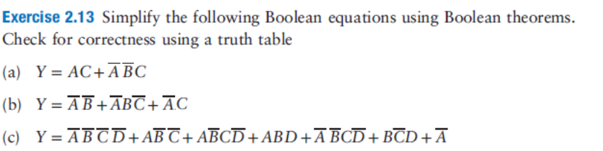
Esercizi

Slide 8
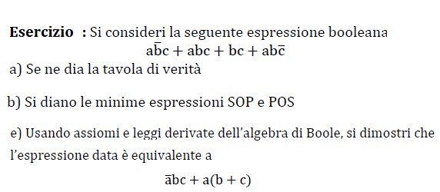
Esercizi

Slide 9
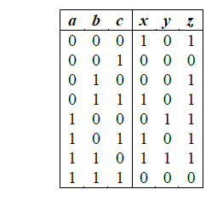
Esercizi
Date le funzioni x,y,z definite dalla tabella di verità:
- Scrivere x,y,z in forma canonica SOP e POS
- Semplificare le forme SOP

Slide 10

Esercizi

